Slide 1
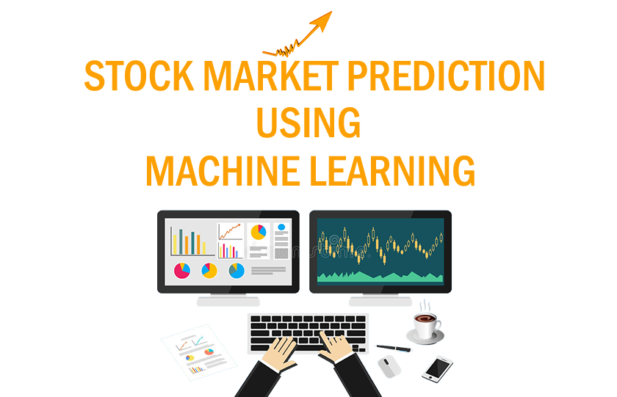

Slide 2


GROUP MEMBERS:
SUPERVISED BY:
Sachin Subedi (565)
Er. Dinesh Gothe
Saugat Dahal (570)
Smriti Tiwari (576)
Susmita Adhikari (587)

Slide 3
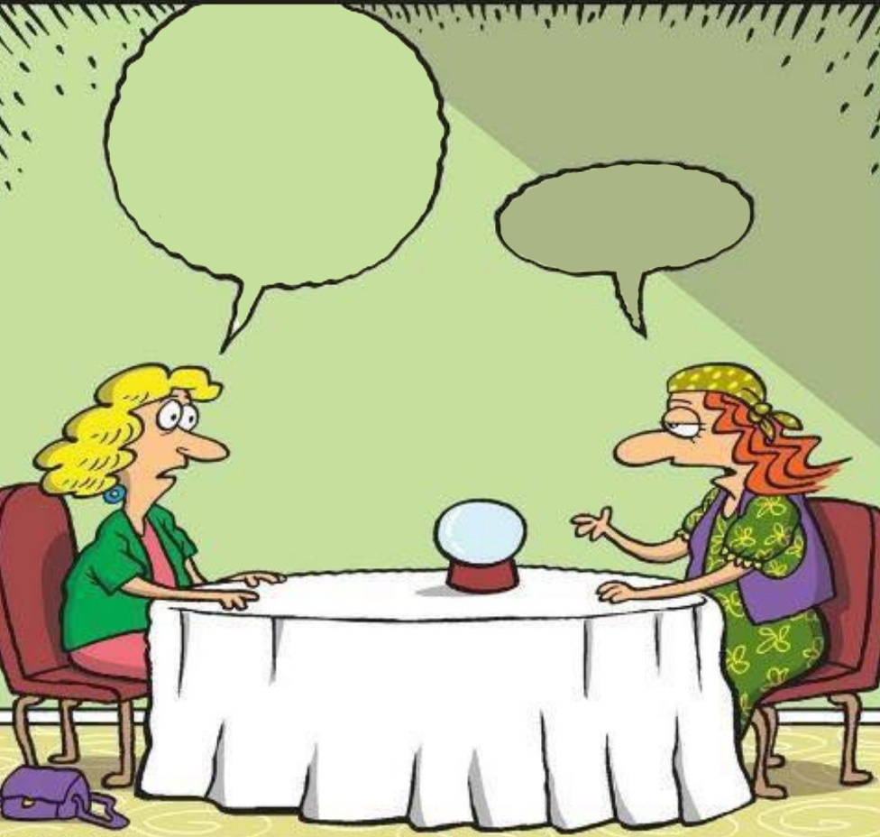
THE HISTORY OF
FORECASTING
Should I BUY Upper tamakoshi shares ???
Well !! your future is bad in stock market
Predicting…

Slide 4
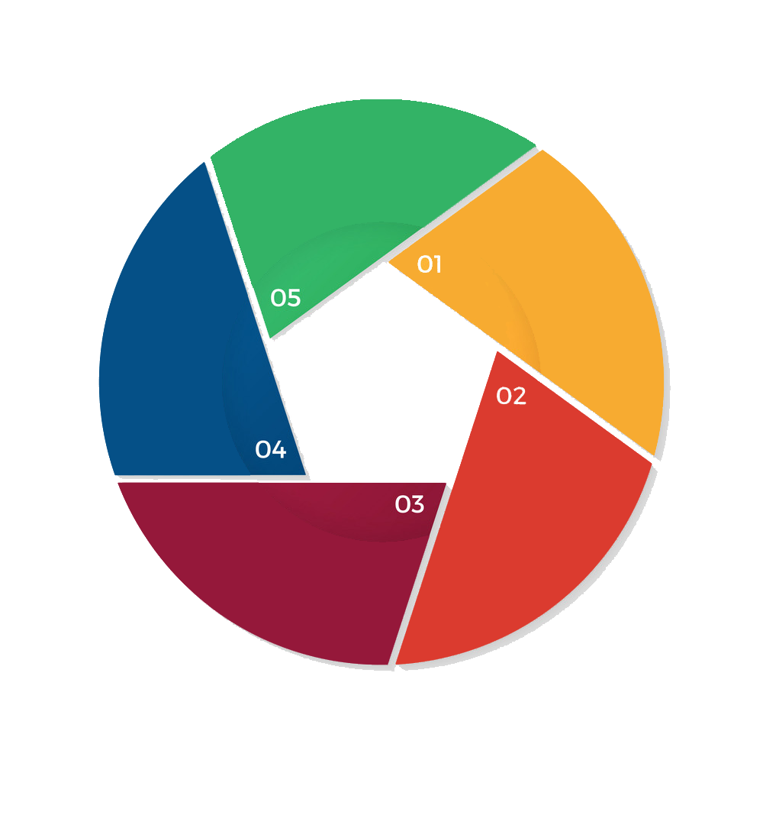
WHY STOCK MARKET ??
Widely used investment scheme which affects the economy of the country
Data source: NEPSE
Successful prediction of market yields significant profit
Investment
Scheme
Non-linear
In nature
Provide generic platform for sellers buyers in the market
Due to non-linear nature of stock market we use machine learning
Significant
Profit
Platform for
Buyers and
sellers
Real time data is extracted from NEPSE

Slide 5
FACTORS IN STOCK MARKET :
Fundamental Factor:
These factors affects the stock prices from outside the organization
Example: Political Situation of the country.
Technical Factor:
These factors affects the stock prices from inside the organization
Example: Annual turnover of the organization.

Slide 6
OBJECTIVE:
The main objective of this project is to predict an approximate value of share price along with the accuracy and recommend users whether they should invest or not.

Slide 7
LITERATURE
REVIEW:
Min and Lee were doing prediction of bankruptcy using machine learning and achieved accuracy of around 60%.
Tsai and Wang did a research where they tried to predict stock prices by and achieved accuracy of 67% and 77%.

Slide 8
LITERATURE
REVIEW:
Wilson and Sharda studied prediction firm bankruptcy using neural networks and classical multiple discriminant analysis.
Kim and Han used a genetic algorithm to transform continuous input values into discrete ones. The genetic algorithm was used to reduce the complexity of the feature space.

Slide 9
SYSTEM DESIGN:
Input
Company
Data
Analysis
Data
Training
Scrapping
Plot
Predicted
Result
Calculate
Performance
Data
Integration
Data
Testing

Slide 10
SYSTEM DESIGN:
THREE MODULES OF SYSTEM
Input :
Web scraping has been done in order to collect the data required for prediction from Nepal Stock Exchange website .
Data Analysis :
Analysis is carried out on the collected data by examining the current market direction and specific companies after which the data is represented and scored accordingly.
Result :
At last, LSTM is designed to predict the stock value. By this we can also recommend users whether to buy or sell shares.

Slide 11
BACK-END
DESIGN :
Use of recurrent neural network with LSTM.
Use of python programming language and its libraries like tensorflow, matplitlib, numpy with machine learning.
Retrieving
Data from
Source
Neural Network Model
Output Prediction
Process for Back-end
Development

Slide 12
SYSTEM NETWORK :
LONG SHORT-TERM MEMORY
Why LSTM ?
LSTM is powerful in sequence prediction problem and able to store past information where RNN cant handle long term dependencies.
But in case of RNN it cannot handle long term dependencies and the memory will loss in a certain time period.
So LSTM is important in our case because the previous price of stock is crucial in predicting the future price.

Slide 13
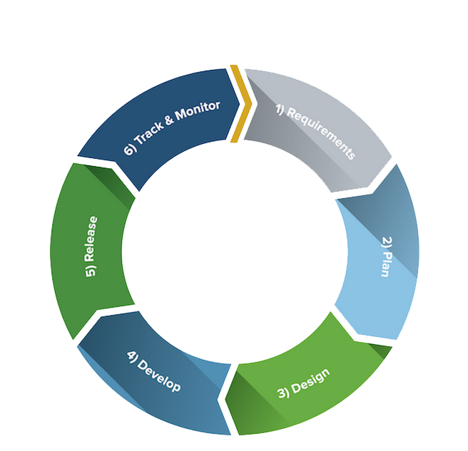
DEVELOPMENT MODEL:
Iterative process
Focuses on process adaptability
Provides rapid delivery of software product
Chaotic nature of stock market fits in this model.
Agile
Development Model

Slide 14
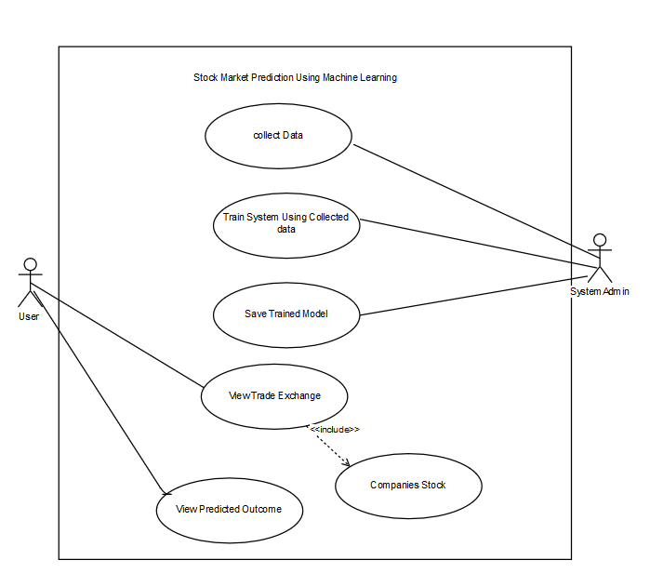
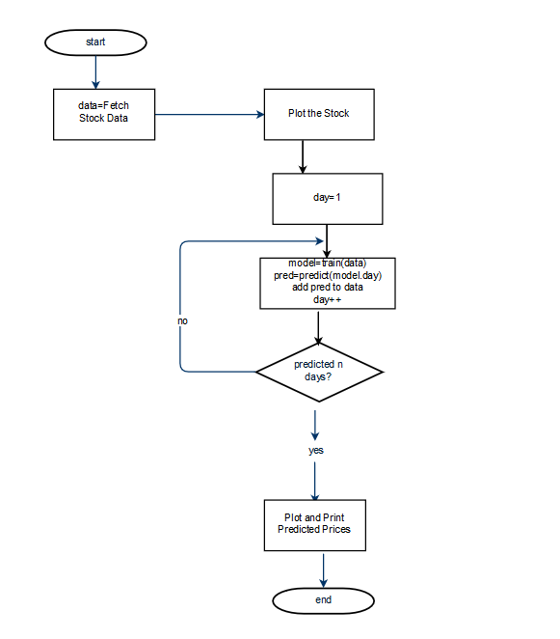
DIAGRAMS:
Use Case Diagram
Flow Chart

Slide 15
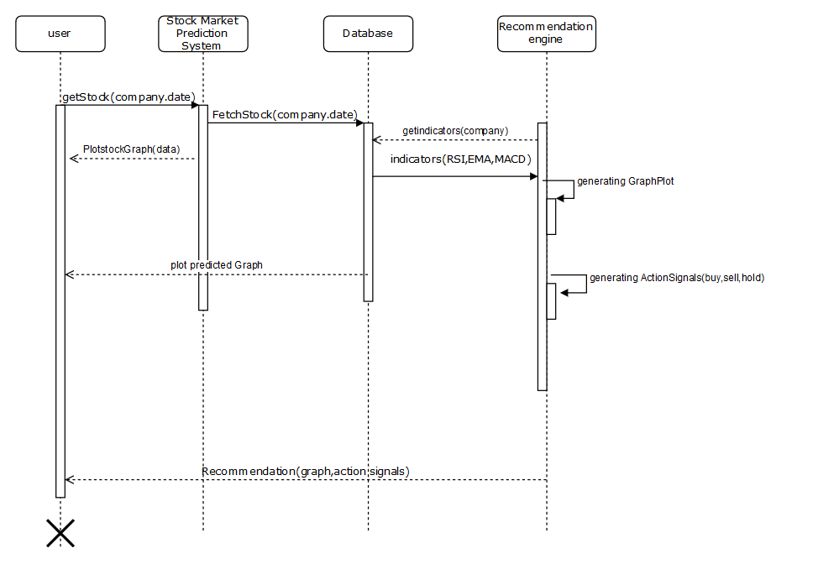
SEQUENCE DIAGRAM:
Sequence Diagram

Slide 16
RESULT AND ANALYSIS:
Scrapping and Pre-processing of Data:
Scrapping from NEPSE
Data Stored in .CSV
Removal of duplicate data, columns
Train and Testing of LSTM Model:
Datasets for training
Datasets for testing
Output produced with accuracy
Recommend whether to hold or sell

Slide 17
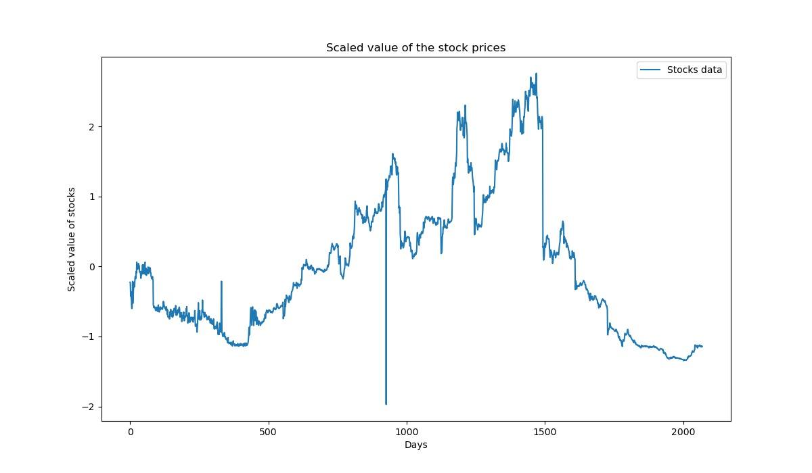
RESULT AND ANALYSIS:
Original Data Plot of Everest Bank

Slide 18
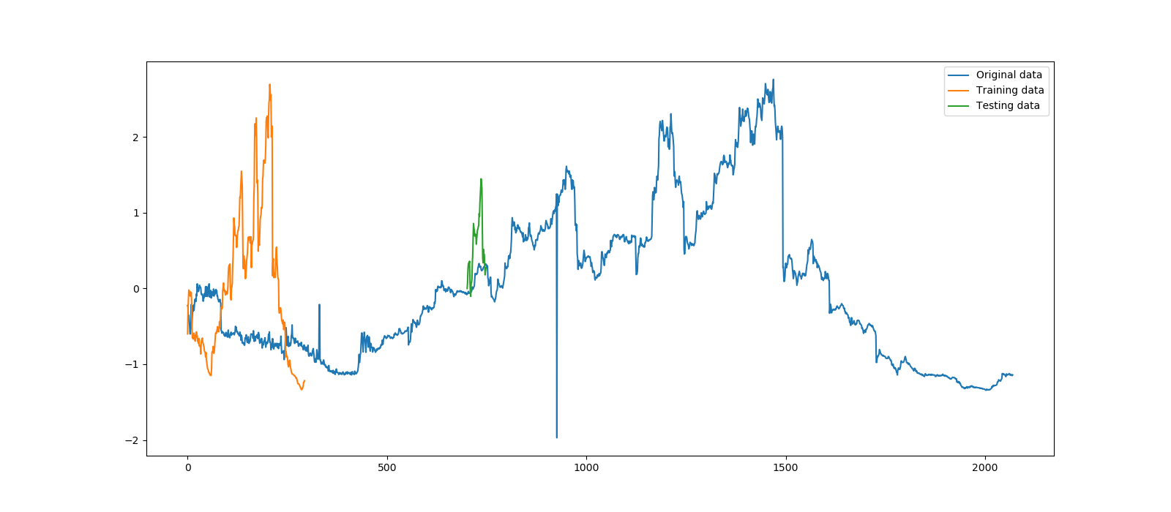
RESULT AND ANALYSIS
Graph Plot of Everest Bank

Slide 19
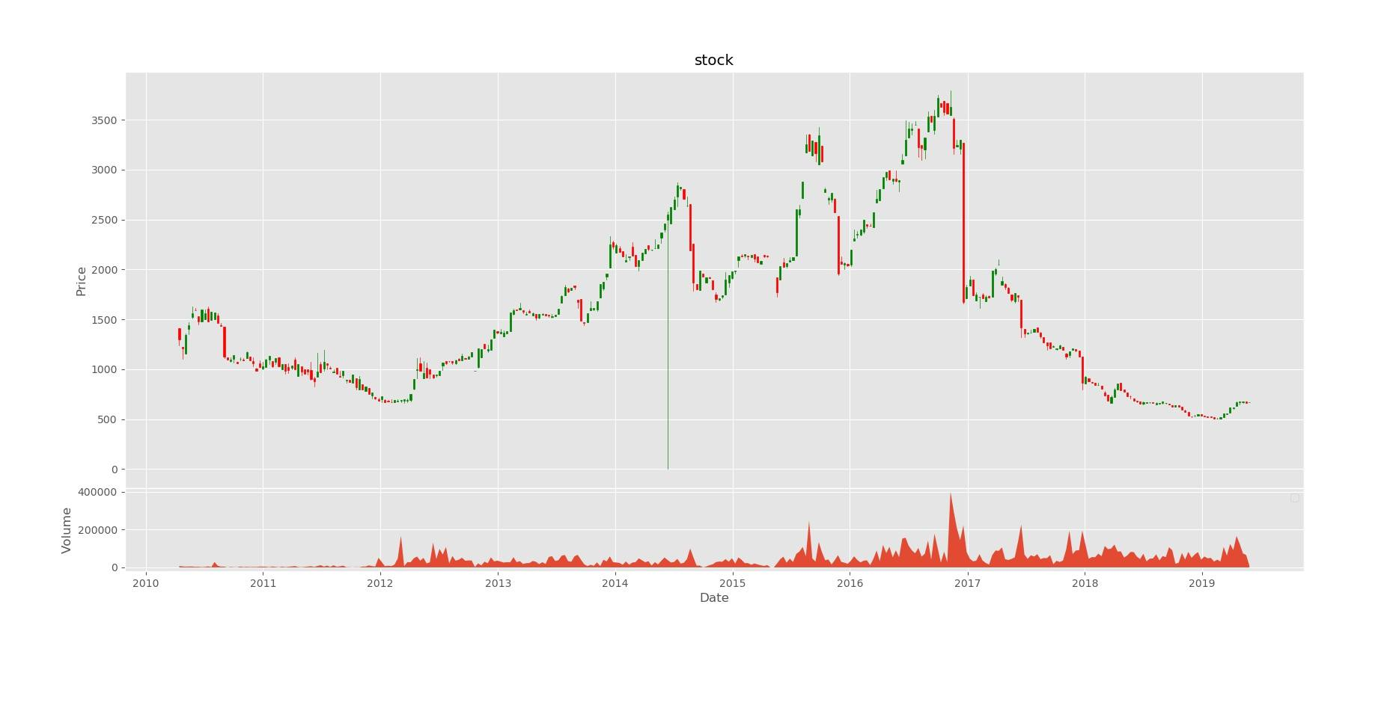
RESULT AND ANALYSIS
OHLC graph of Everest Bank

Slide 20
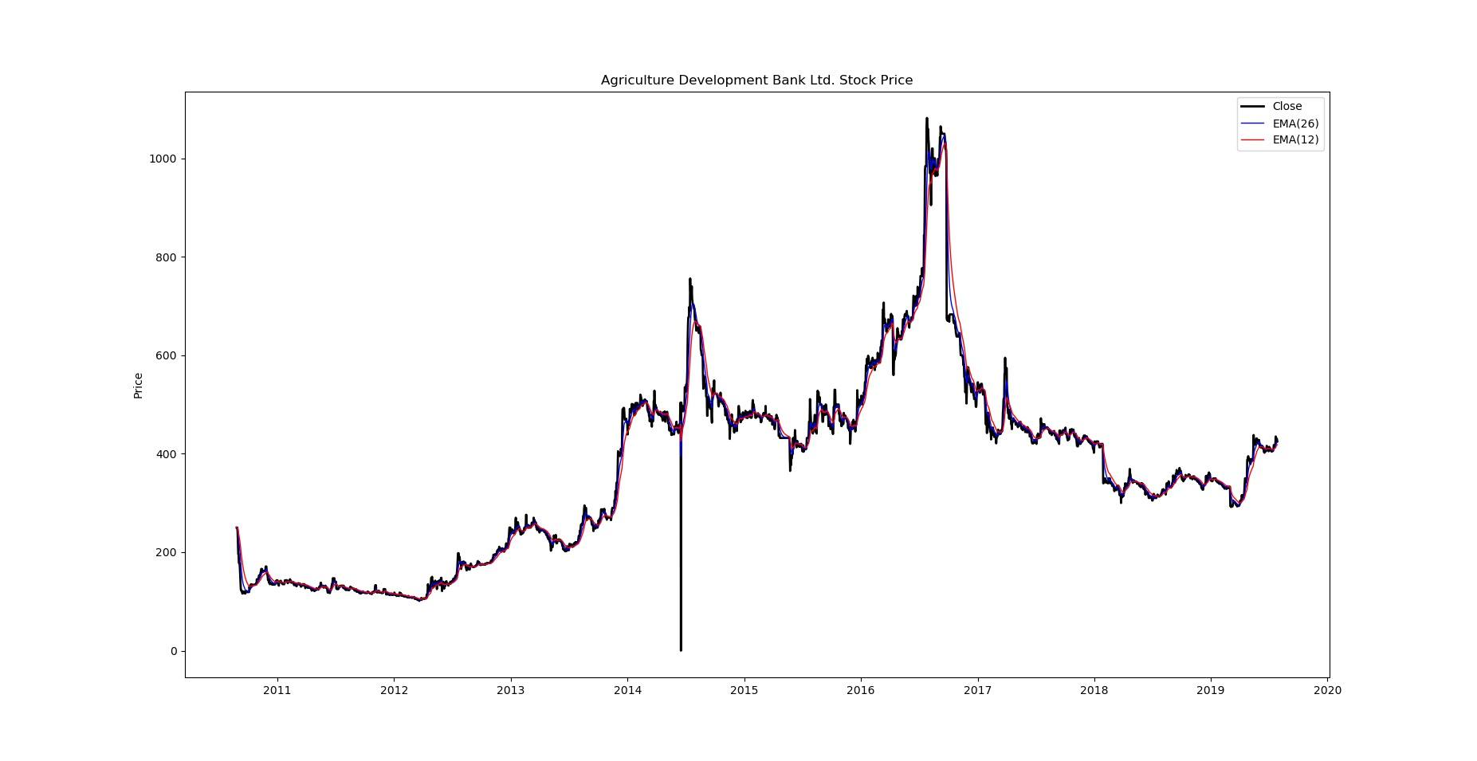
RESULT AND ANALYSIS
EMA graph of Agricultural Development Bank

Slide 21
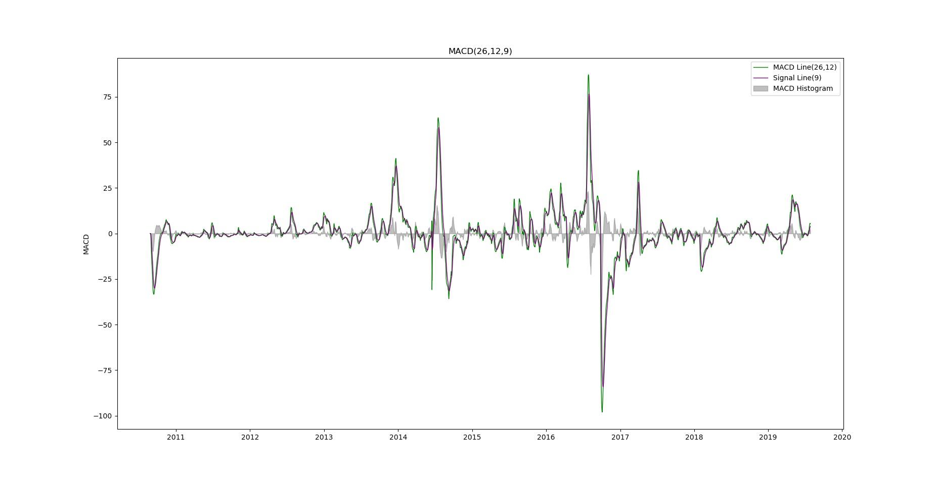
RESULT AND ANALYSIS
MACD graph of Agricultural Development Bank

Slide 22
CONCLUSION:
Applicable for buyers and sellers.
Flexible in share trading.

Slide 23
FUTURE WORK:
Web based UI design.
Automatically data update.
Development of Android Application.

Slide 24
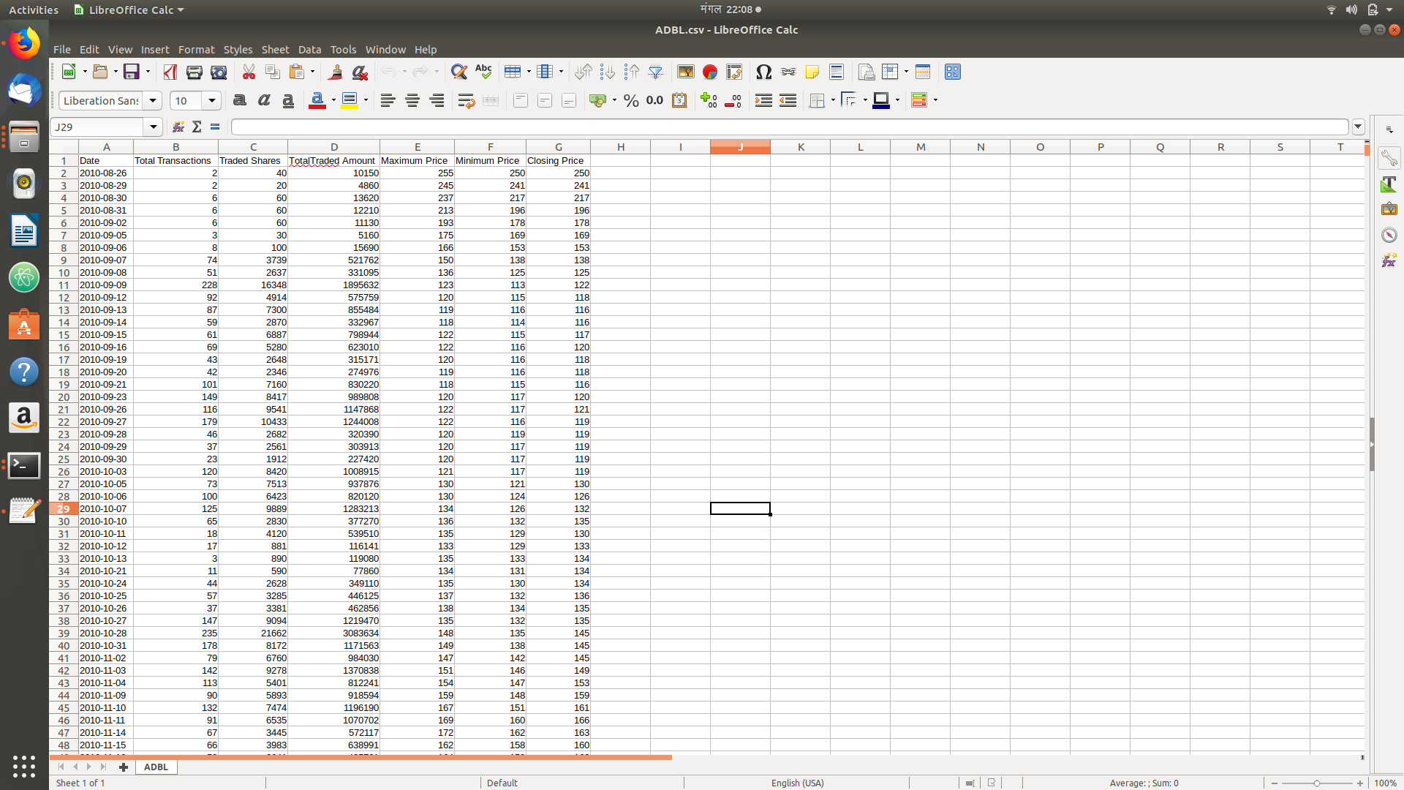
SCREENSHOTS:
CSV file of Scrapped Data from NEPSE

Slide 25
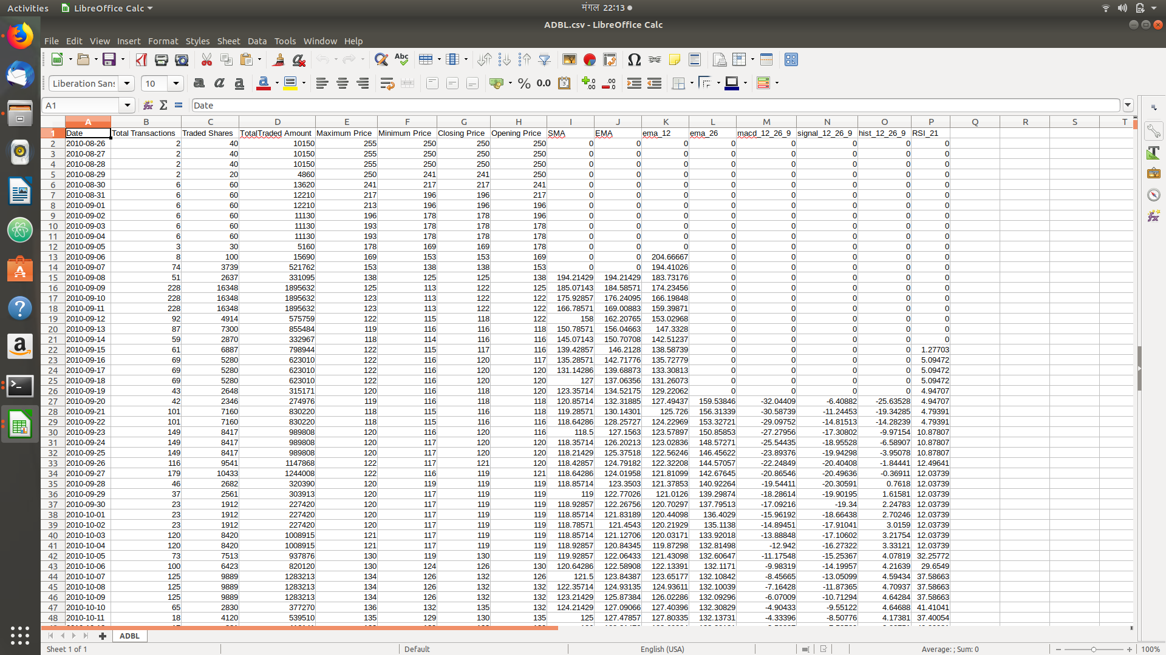
SCREENSHOTS:
CSV file after being processed for recommendation system

Slide 26
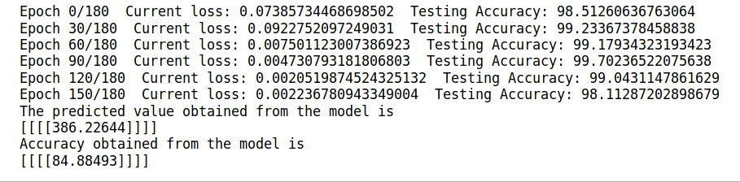
SCREENSHOTS:
Calculated Performance of Model

Slide 27
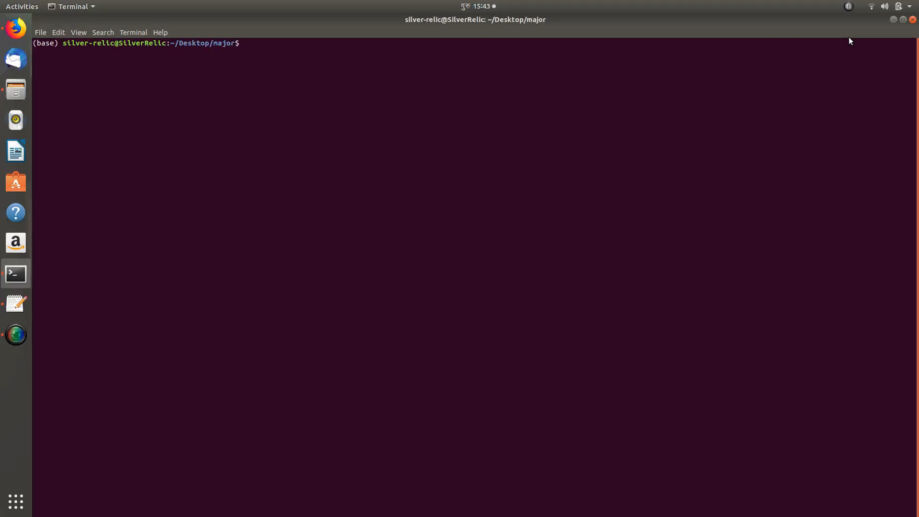
SCRAPPING
DEMO

Slide 28
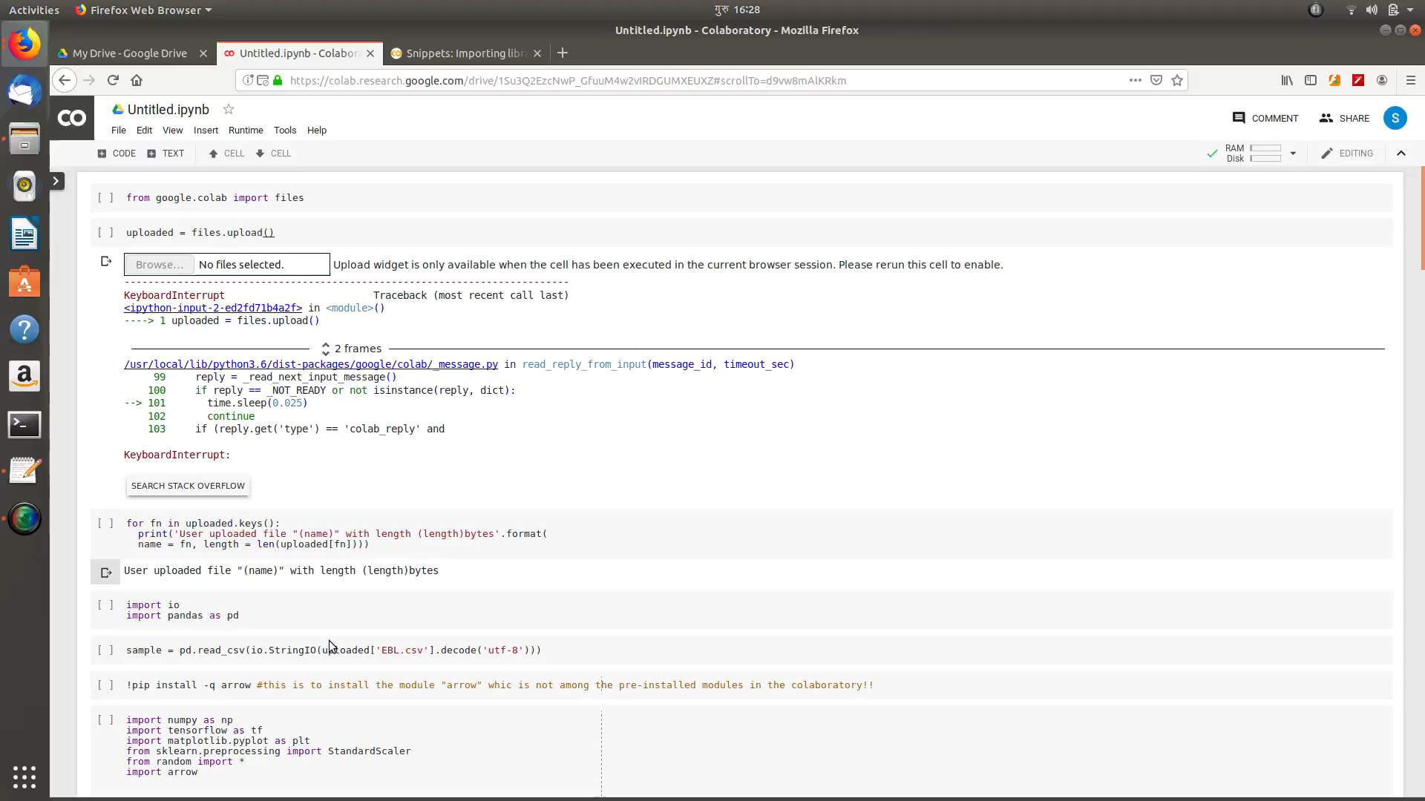
MODEL
DEMO

Slide 29
THANK YOU !!!

